Slide 1
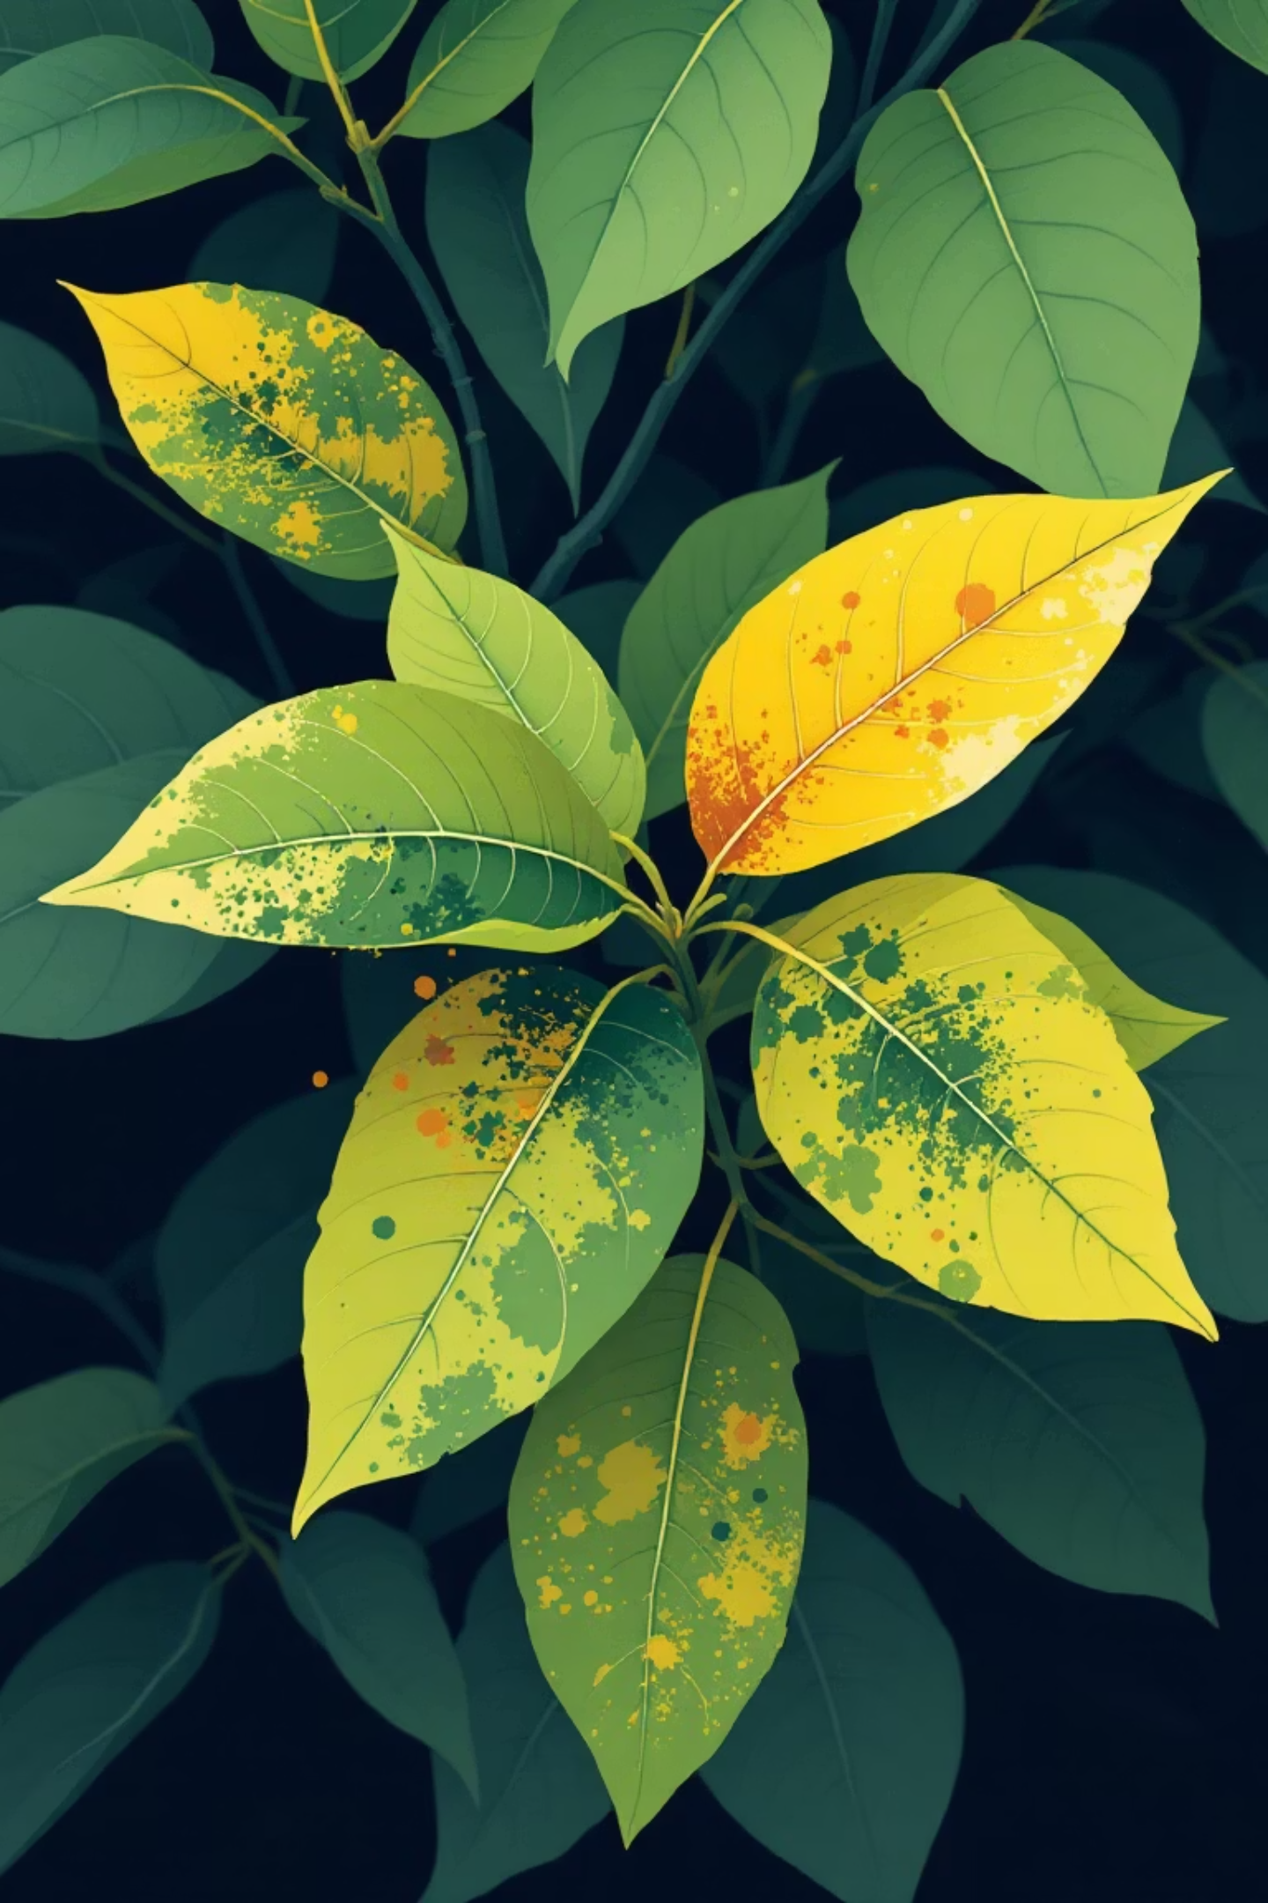
AgroScan:Citrus Leaf Disease Detection

Slide 2
TEAM MEMBERS
1. G.Yagneswari -(RO200402)
2. B.Triveni -(RO200472)
3. V.Dattatraya -(RO201045)

Slide 3
Abstraction
This project abstracts the challenge of automatic citrus leaf disease detection and classification using deep learning-based image analysis. By leveraging convolutional neural networks such as ResNet101, DenseNet201, and AlexNet, the system learns to extract distinguishing features from leaf images, enabling robust identification of diseases like Black spot, Canker, Greening, and Melanose, as well as recognition of healthy specimens. The workflow encompasses systematic data collection, preprocessing, augmentation, model training, and quantitative evaluation using metrics such as accuracy, precision, recall, and F1-score. The solution not only provides timely support for farmers and agronomists, but also demonstrates the application of advanced machine learning techniques for real-world agricultural diagnostics, minimizing manual intervention and enhancing crop management.

Slide 4
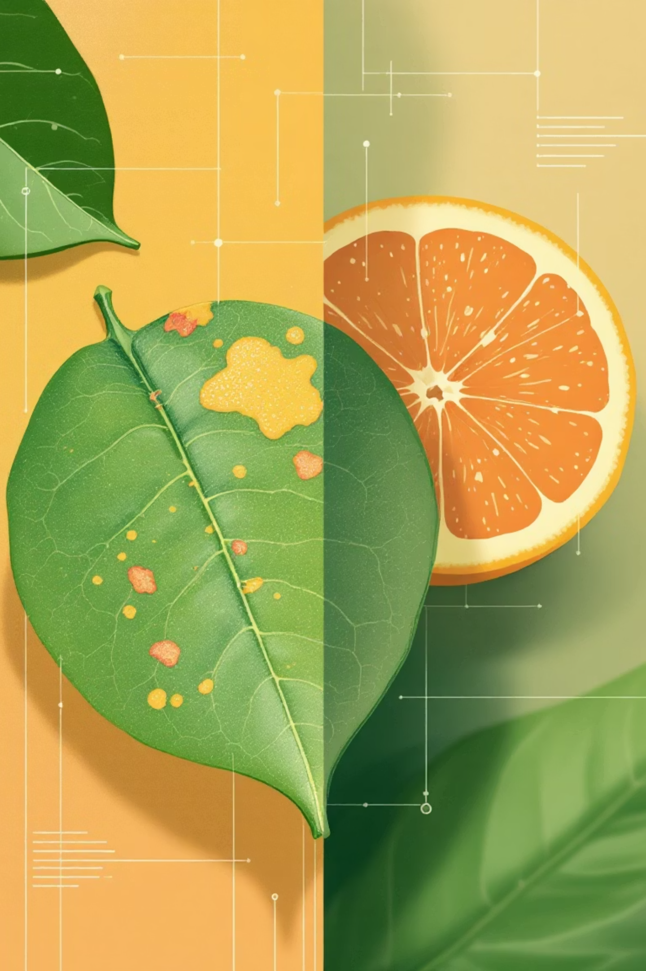
Introduction: Empowering Citrus Health with AI
Citrus crops are vital to global agriculture and economies, but they are constantly threatened by various diseases. Early and accurate detection is paramount to prevent widespread crop loss and ensure sustainable production. This presentation explores how deep learning, specifically models like ResNet101, DenseNet201, and AlexNet, offers a revolutionary approach to diagnosing these diseases with unprecedented efficiency and precision.

Slide 5




Why Detect Citrus Leaf Diseases Early?
Crop Contribution
Disease Impact
Citrus crops contribute over 30% of fruit production in key agricultural regions like Punjab, India, and Pakistan.
Diseases like Black Spot, Canker, Greening (Huanglongbing), and Melanacies drastically reduce yield and fruit quality, leading to significant economic losses for farmers.
Traditional Challenges
Deep Learning Solution
Traditional manual diagnosis is slow, costly, and prone to human error, risking widespread crop loss if not addressed promptly.
Automated detection using deep learning offers rapid, accurate, and scalable solutions for farmers, enabling timely intervention.

Slide 6
Challenges in Citrus Disease Detection Using Deep Learning
Data Acquisition & Annotation
Inter-class Similarity
Building high-quality, diverse datasets covering various disease stages, lighting conditions, and citrus varieties is a time-consuming and expensive process.
Many citrus diseases present visually similar symptoms, making it challenging for deep learning models to distinguish between them with high accuracy.
Environmental Variability
Model Generalizability & Deployment
Real-world conditions like inconsistent lighting, leaf overlap, dust, and pest damage can severely impact model performance and lead to misclassifications.
Models often struggle to generalise across different geographic regions or citrus species. Deploying complex models on resource-limited farm devices presents another significant hurdle.

Slide 7



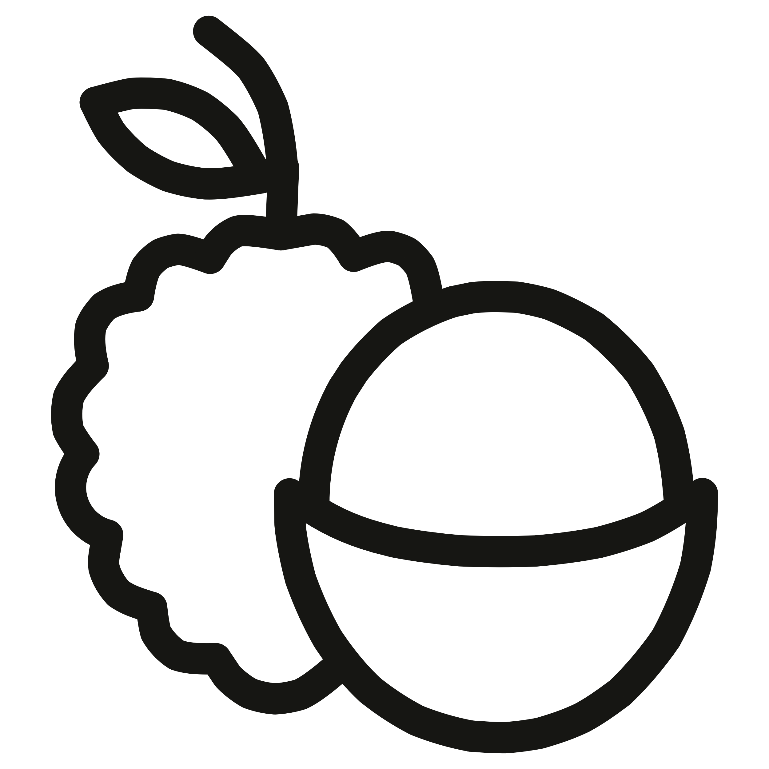
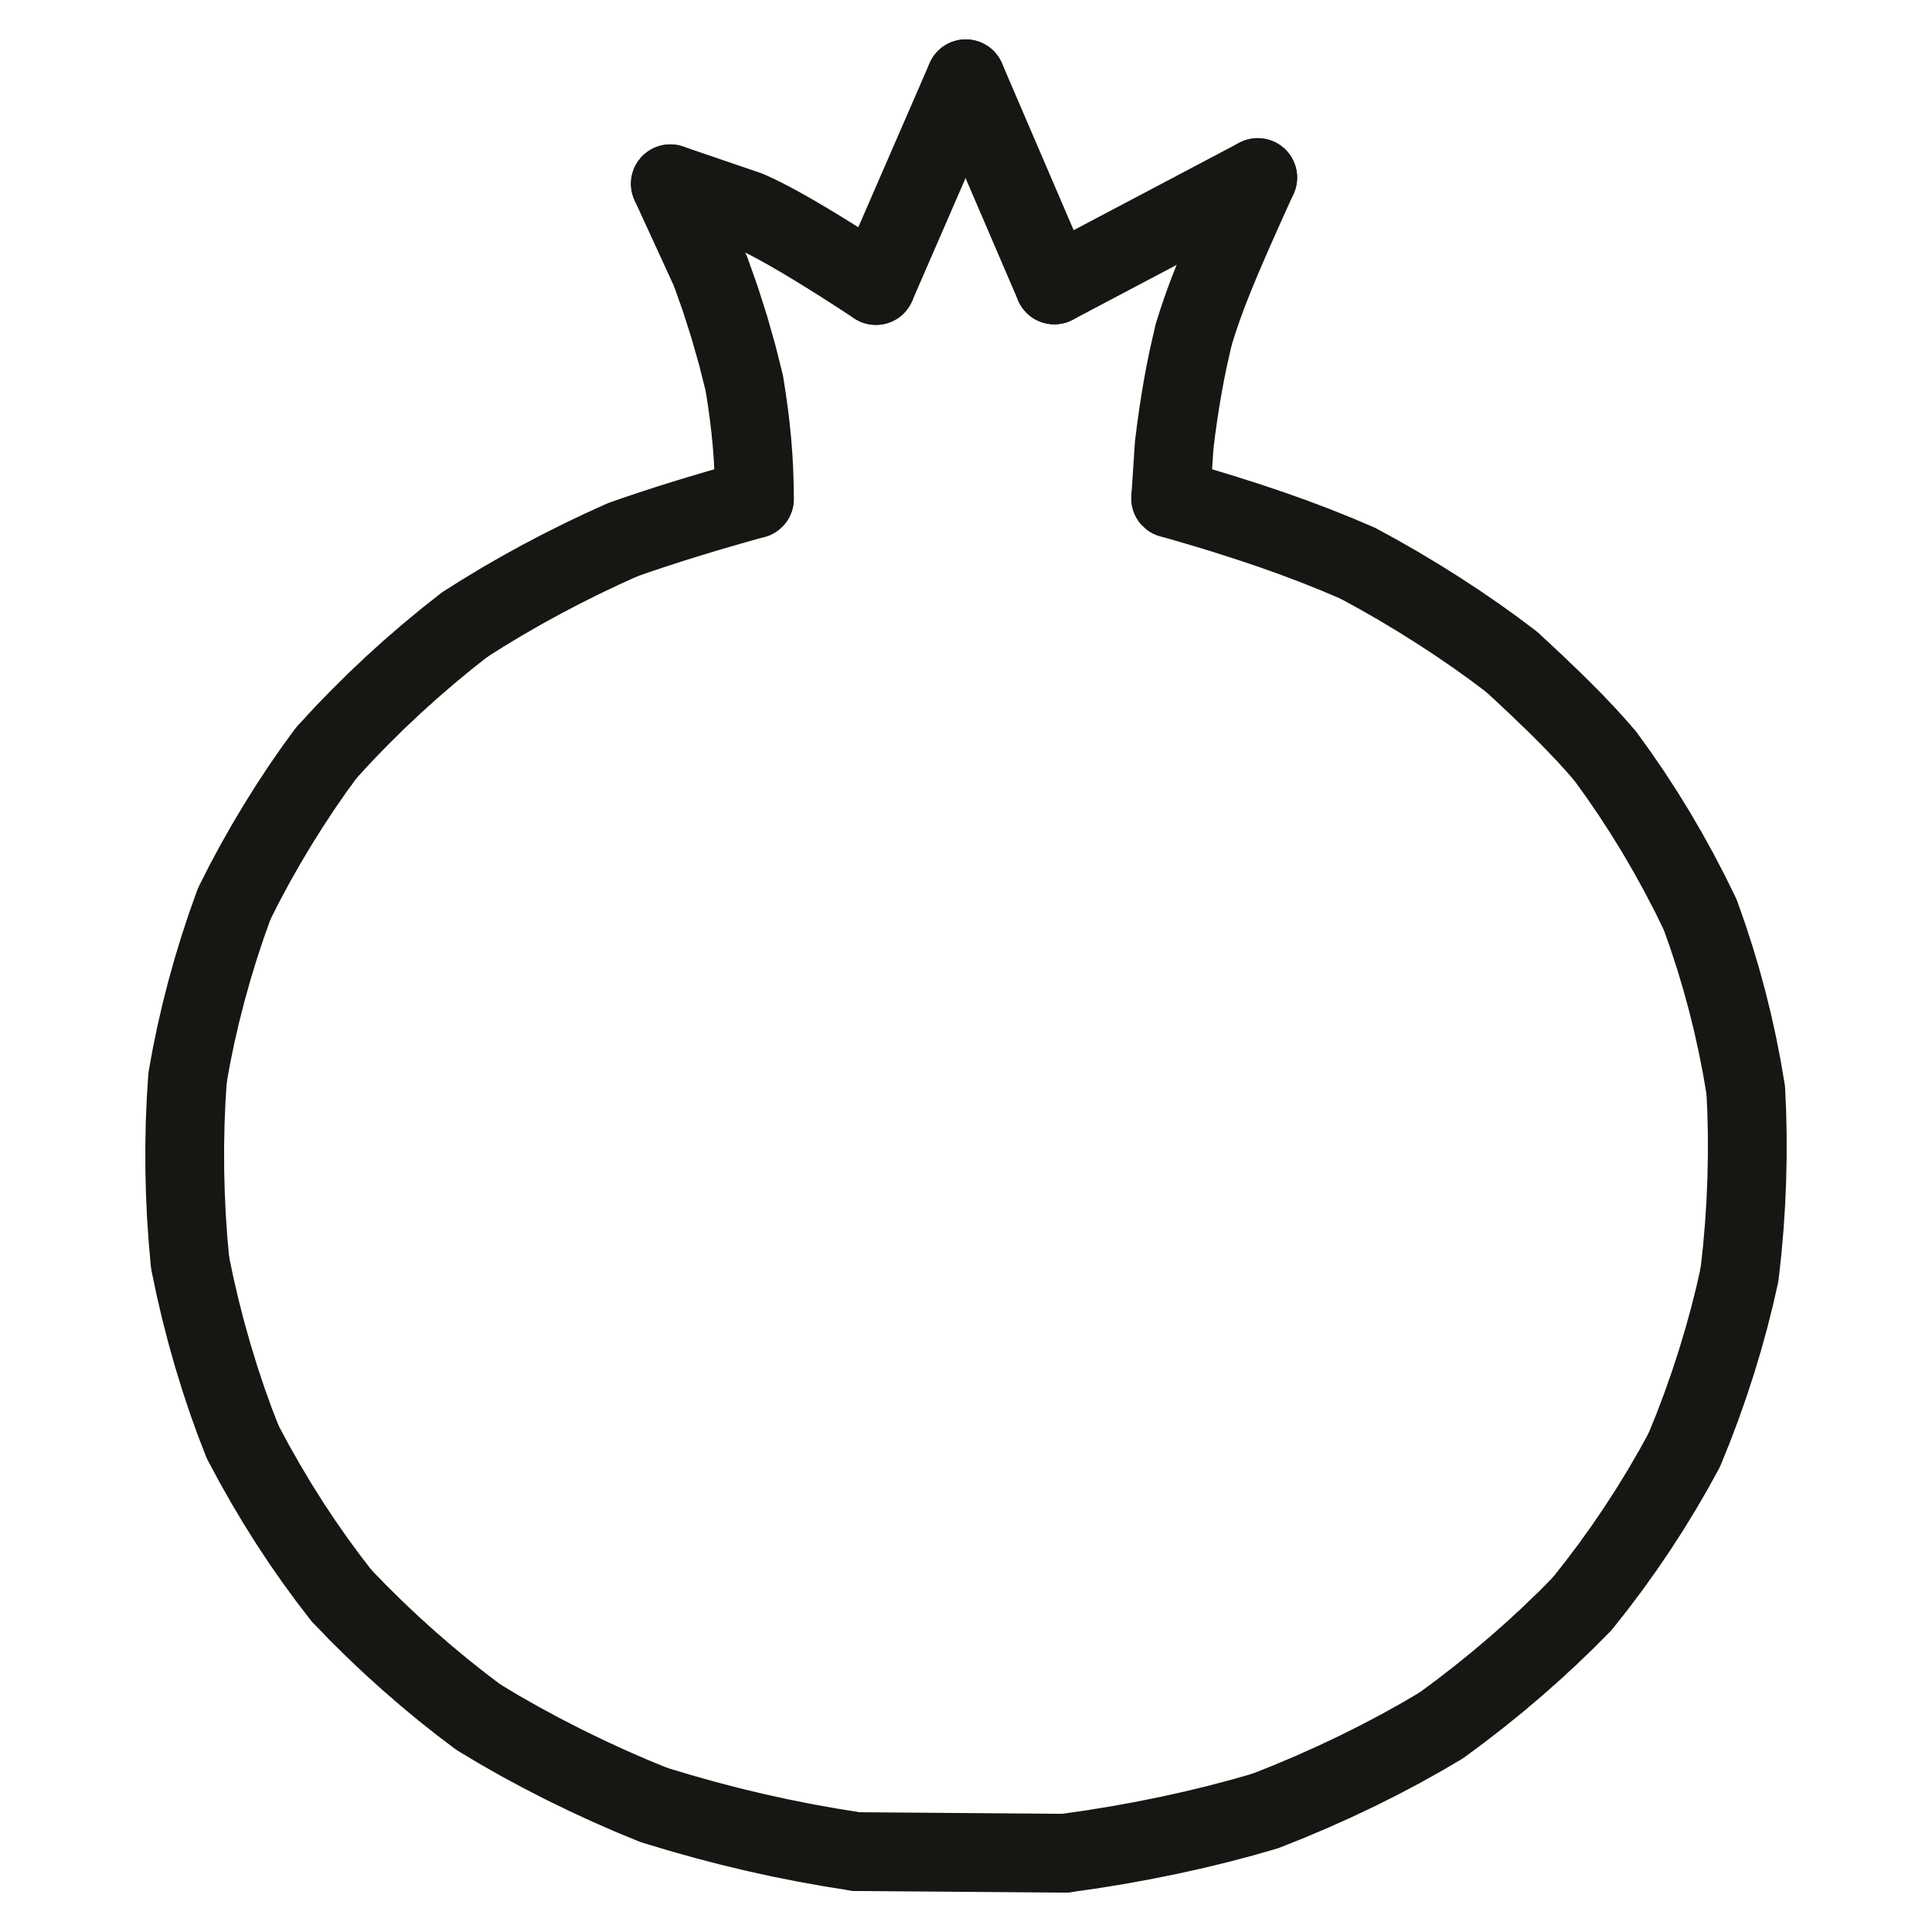
Dataset Overview: Understanding the Disease Classes
Our deep learning models were trained and validated on a comprehensive dataset comprising images of citrus leaves categorised into five distinct classes, crucial for accurate disease identification.
Black Spot
Characterised by dark, sunken circular lesions on leaves, often surrounded by a yellow halo, indicative of a fungal infection.
Greening (HLB)
Displays asymmetrical yellowing or mottling patterns on leaves, appearing blotchy and uneven, signifying a severe bacterial disease.
Canker
Features raised, corky lesions with a watery margin and a distinct yellow halo, primarily affecting the leaves and fruit.
Melanose
Identified by small, raised, dark brown or black spots that give the leaf a sandpaper-like texture, often merging into larger affected areas.
Healthy
Represents uniformly vibrant green leaves with a smooth texture, entirely free from any visible symptoms of disease or damage.

Slide 8



Deep Learning Models: AlexNet, ResNet101, DenseNet201
To achieve robust citrus leaf disease detection, we leverage the distinct strengths of three state-of-the-art Convolutional Neural Network (CNN) architectures. Each model brings unique capabilities in processing and classifying intricate visual patterns found in leaf images.
AlexNet: The Pioneer
A groundbreaking CNN architecture, AlexNet significantly advanced image recognition with its eight-layer design and ReLU activation functions, laying the foundation for modern deep learning breakthroughs.
ResNet101: Deep Residual Learning
ResNet101 introduced residual connections, allowing the training of extremely deep networks (101 layers) by mitigating the vanishing gradient problem, thereby enabling the extraction of highly complex features.
DenseNet201: Feature Reuse Efficiency
DenseNet201 promotes feature reuse through dense connectivity, where each layer receives inputs from all preceding layers, leading to fewer parameters and improved performance in discerning subtle disease patterns.

Slide 9
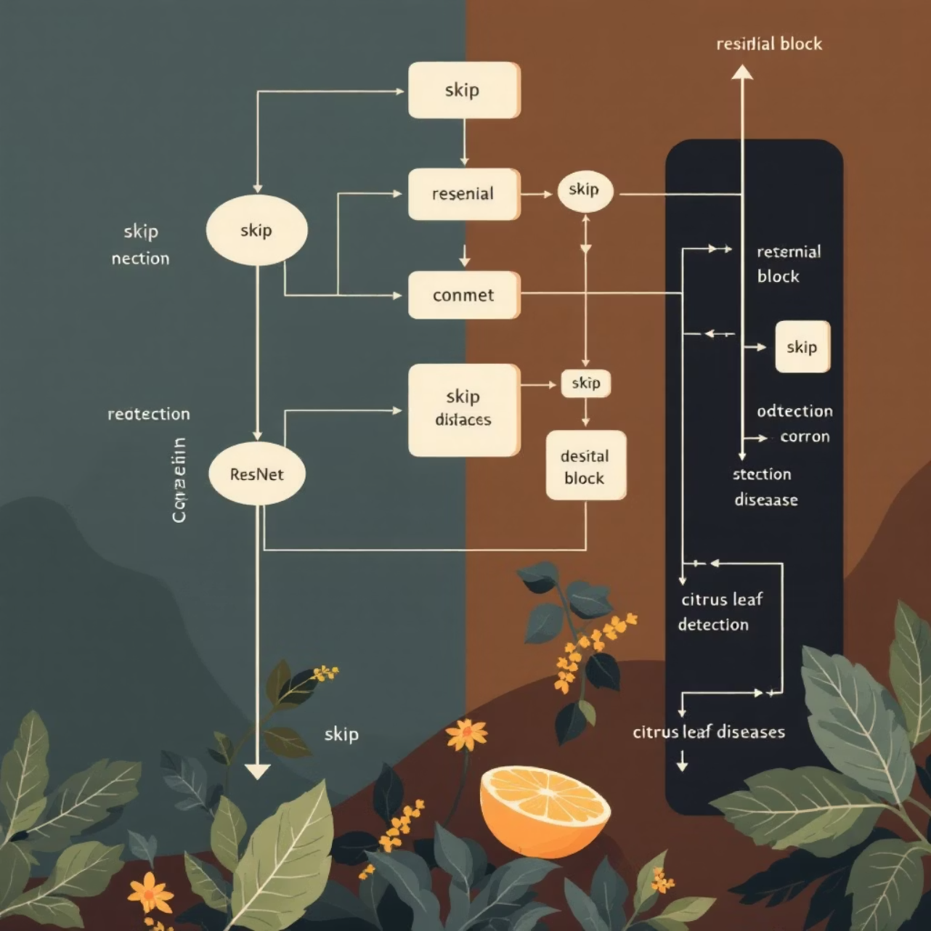
ResNet101: Deep Residual Learning for Citrus Disease
ResNet101 is engineered with residual blocks incorporating identity shortcuts, allowing for the effective training of extremely deep networks without performance degradation.
This architecture is highly capable of capturing intricate disease patterns, such as subtle colour changes associated with greening or the distinct lesions of canker.
A significant advantage of ResNet is its ability to mitigate the degradation problem, a common issue in very deep neural networks where accuracy saturates and then rapidly degrades.
Studies have shown that ResNet101 can achieve remarkably high accuracy, approaching ~99.6%, on diverse citrus leaf disease datasets, making it highly effective for precise diagnostics.

Slide 10
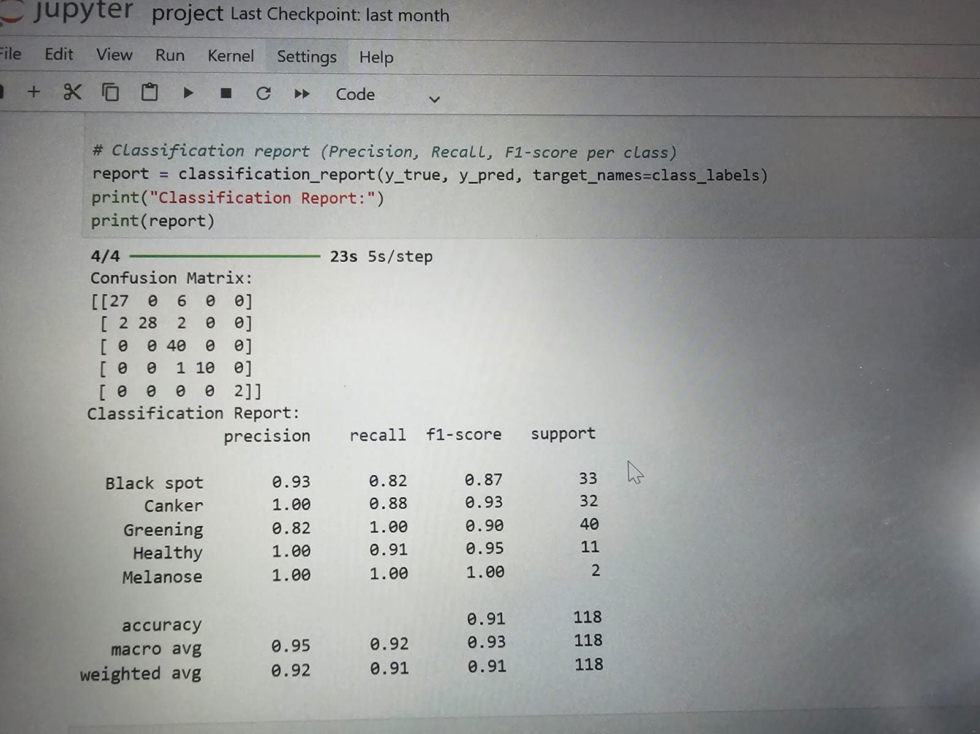
Confusion Matrix And Classification Report

Slide 11
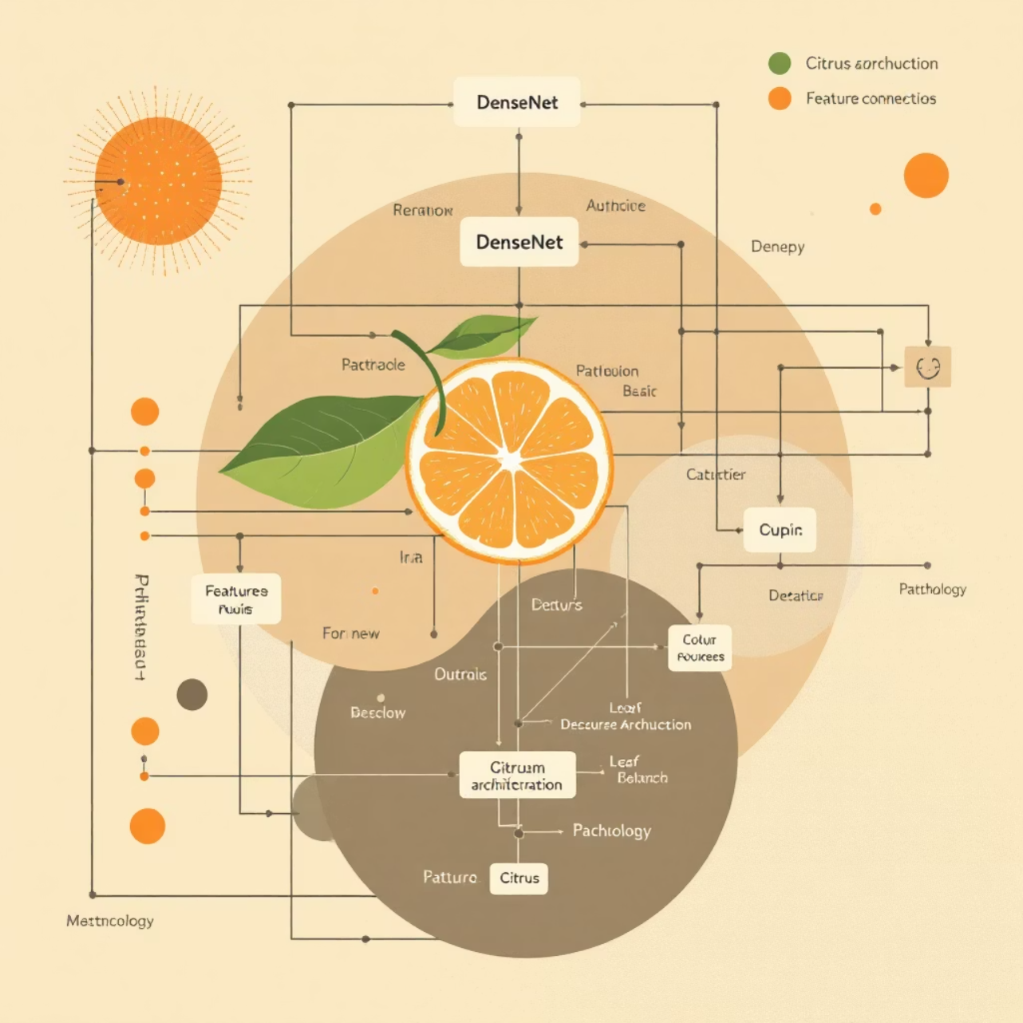
DenseNet201: Feature Reuse for Robust Detection
DenseNet201's architecture is characterised by its dense connectivity pattern, where each layer directly connects to every subsequent layer, ensuring maximum information flow throughout the network.
This dense connectivity allows the model to efficiently capture multi-scale features, ranging from small spots and textures to larger lesion shapes, which are crucial for accurate disease identification.
Despite its profound depth, DenseNet201 typically requires fewer parameters compared to other very deep models like ResNet, due to its efficient feature reuse mechanism.
It proves particularly effective in distinguishing between visually similar diseases, for example, differentiating between black spot and melanacies, which often pose challenges for other models.

Slide 12
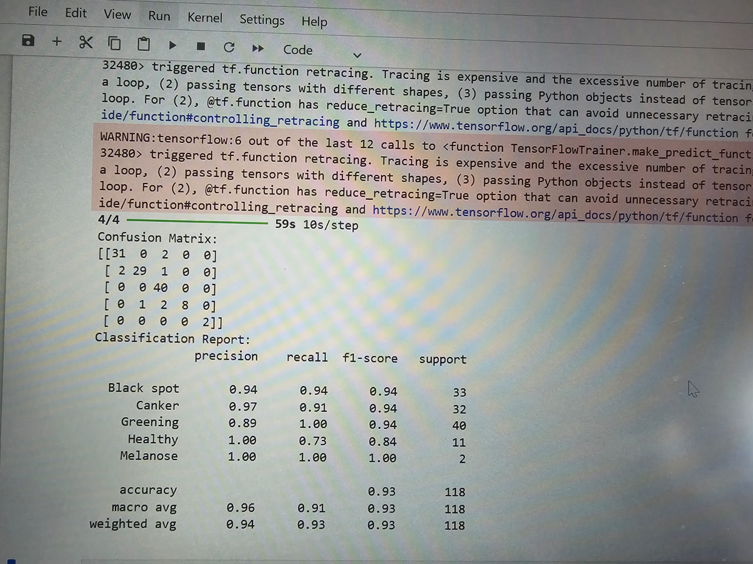
Confusion Matrix And Classification Report

Slide 13
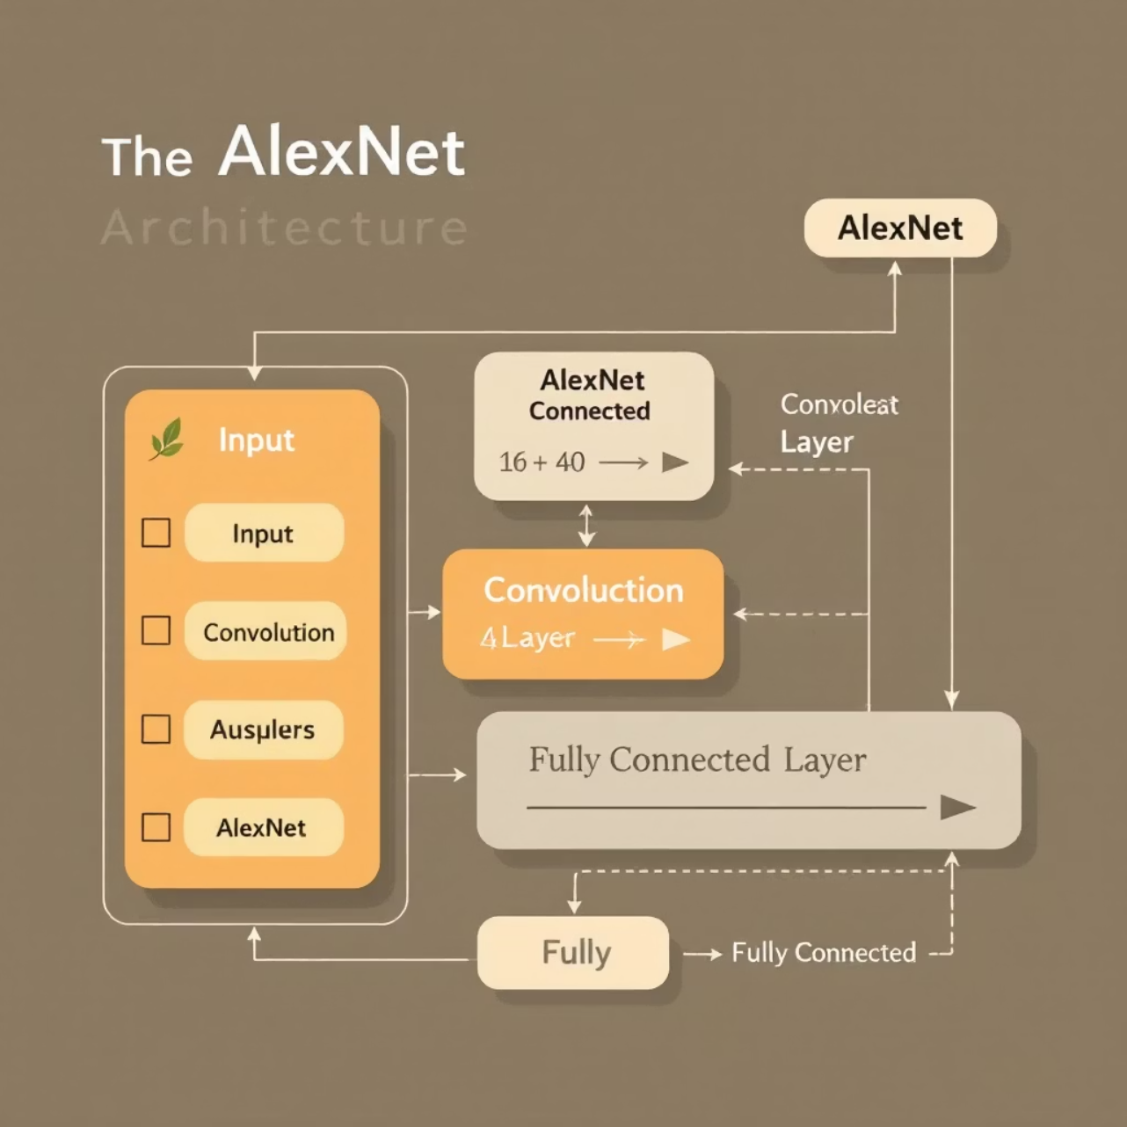
How AlexNet Works for Classification
AlexNet processes input images by resizing them to 227x227 pixels.
It employs a series of convolutional layers to automatically extract fundamental features such as edges, textures, and simple shapes from the citrus leaf images.
These extracted features are then fed into fully connected layers, which are responsible for classifying the images into specific disease categories.
Its primary strength lies in its relatively faster training time and simpler architectural design.
However, a key limitation is its reduced accuracy when dealing with complex and subtle disease features that require more intricate pattern recognition.

Slide 14
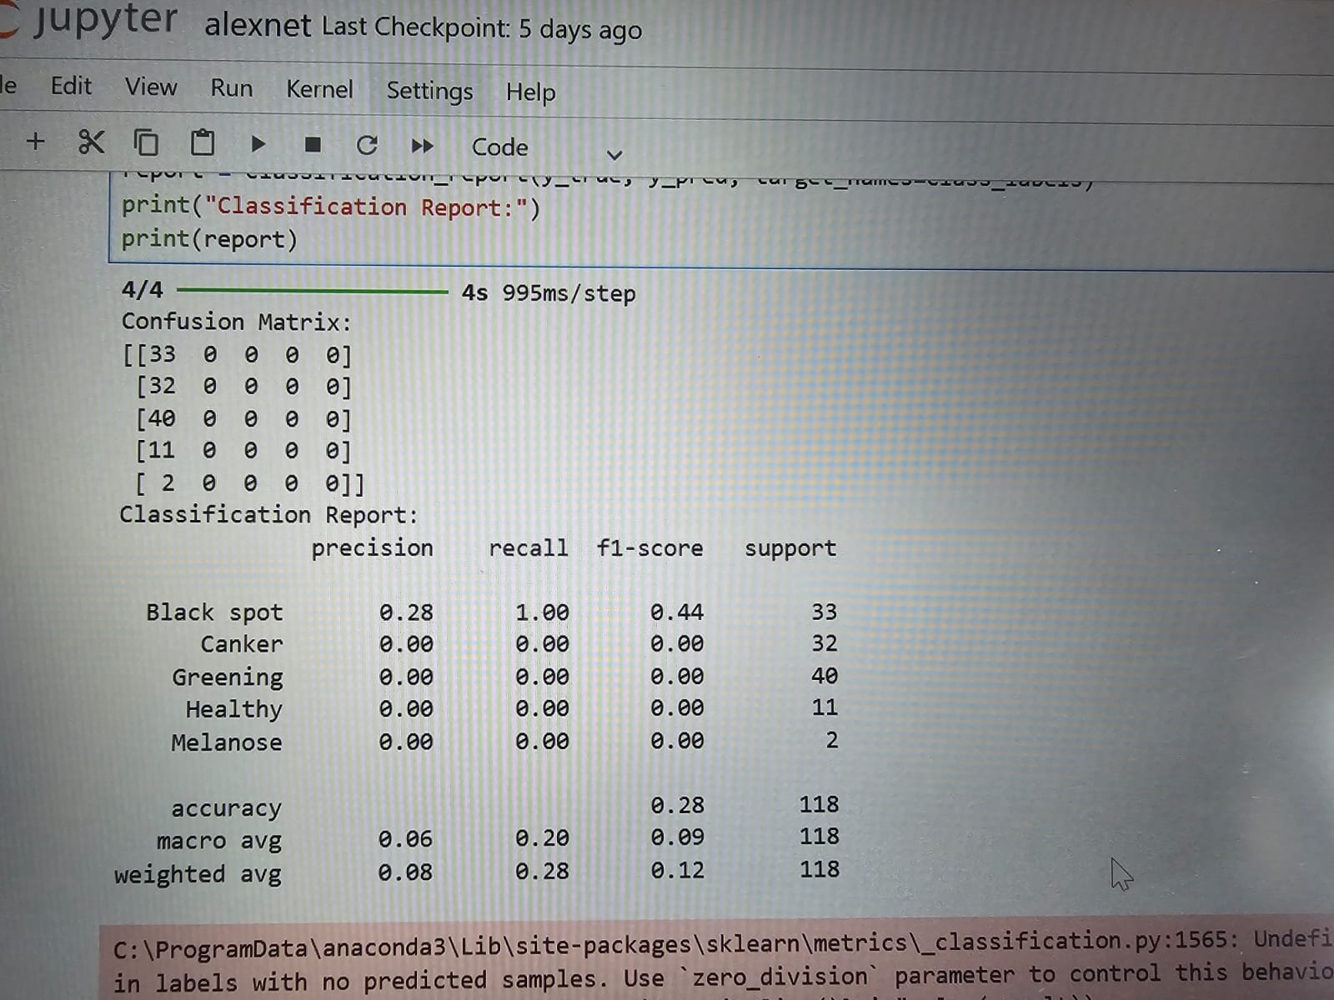
Confusion Matrix And Classification Report

Slide 15
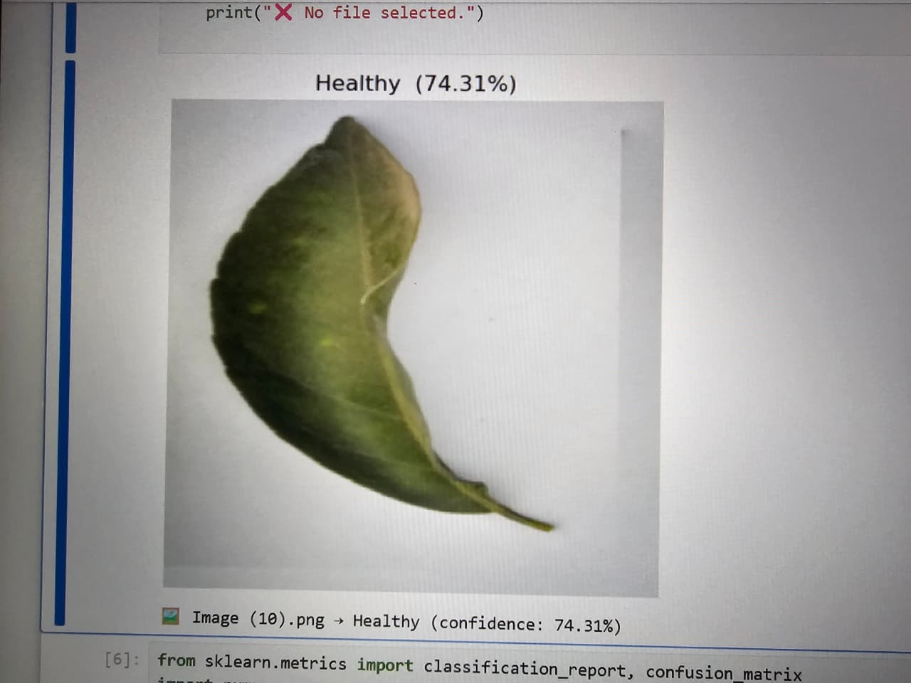
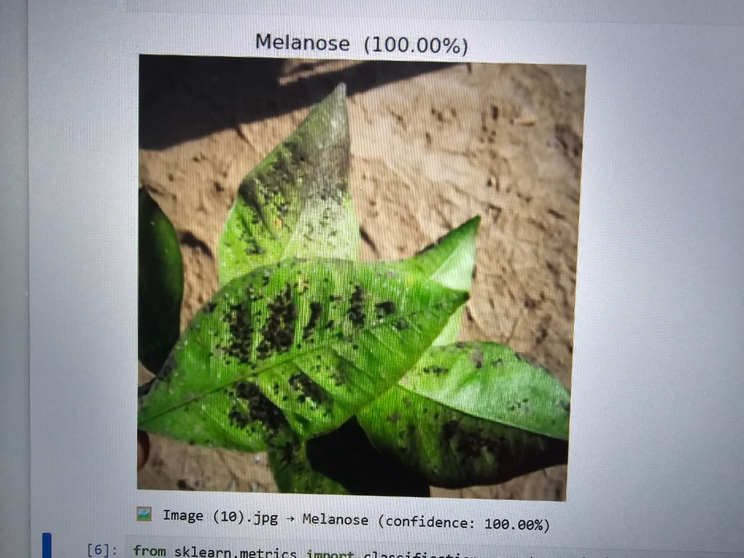
OUTPUTS

Slide 16
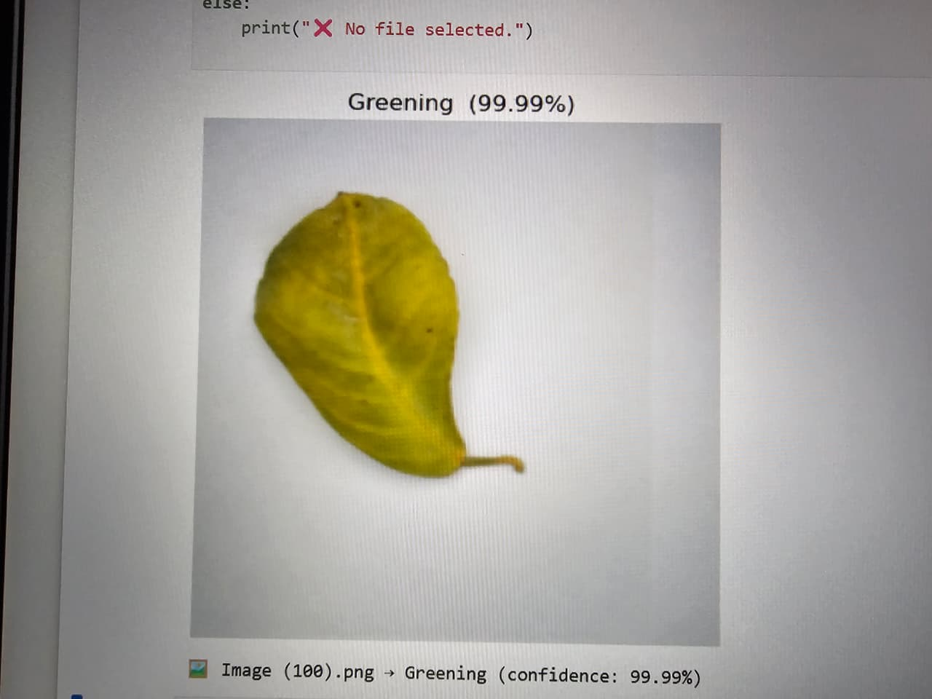
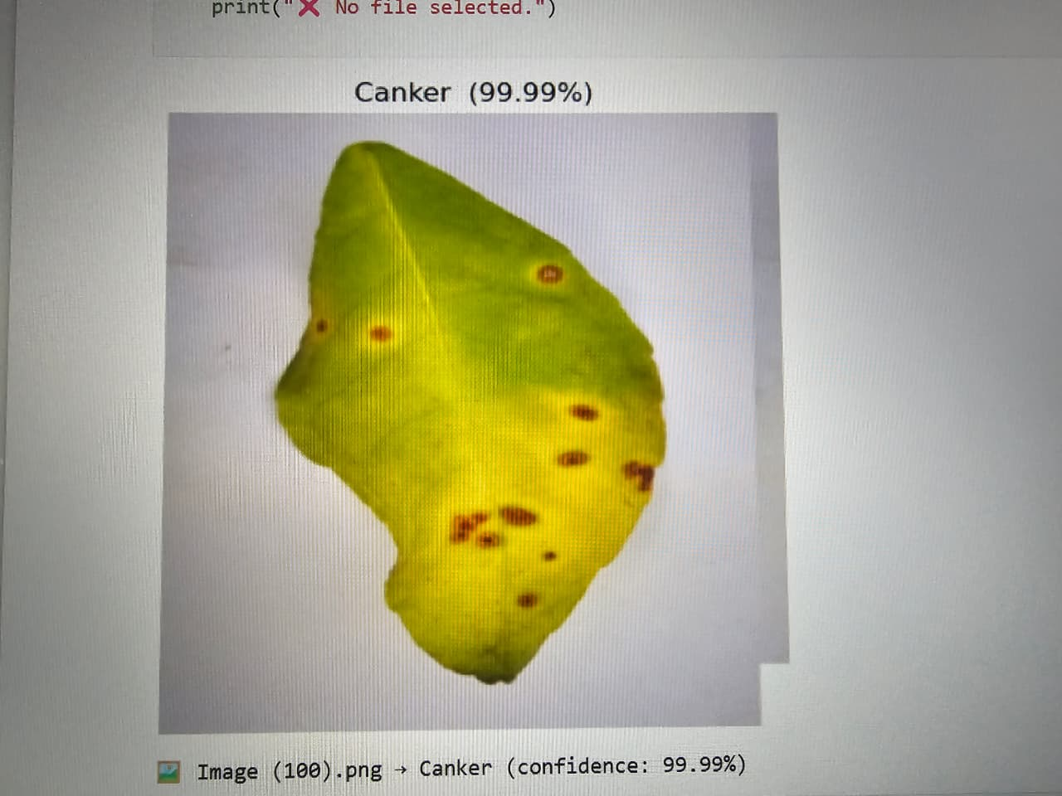
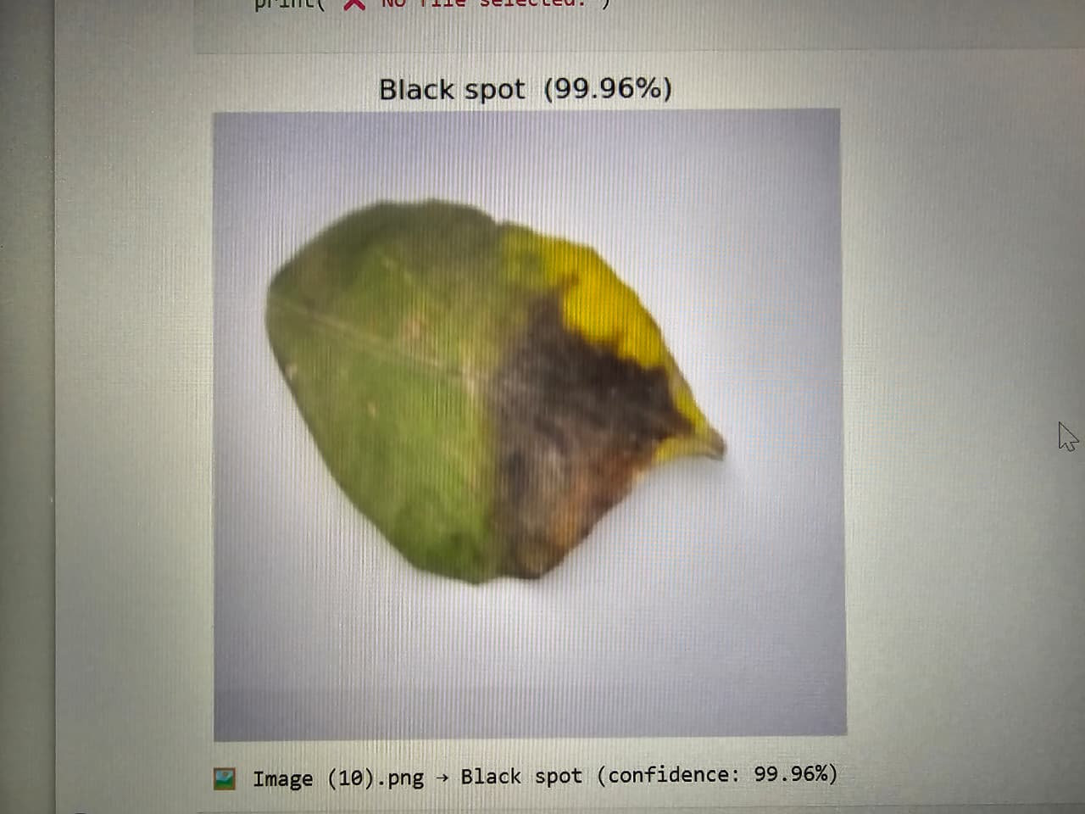
OUTPUTS

Slide 17
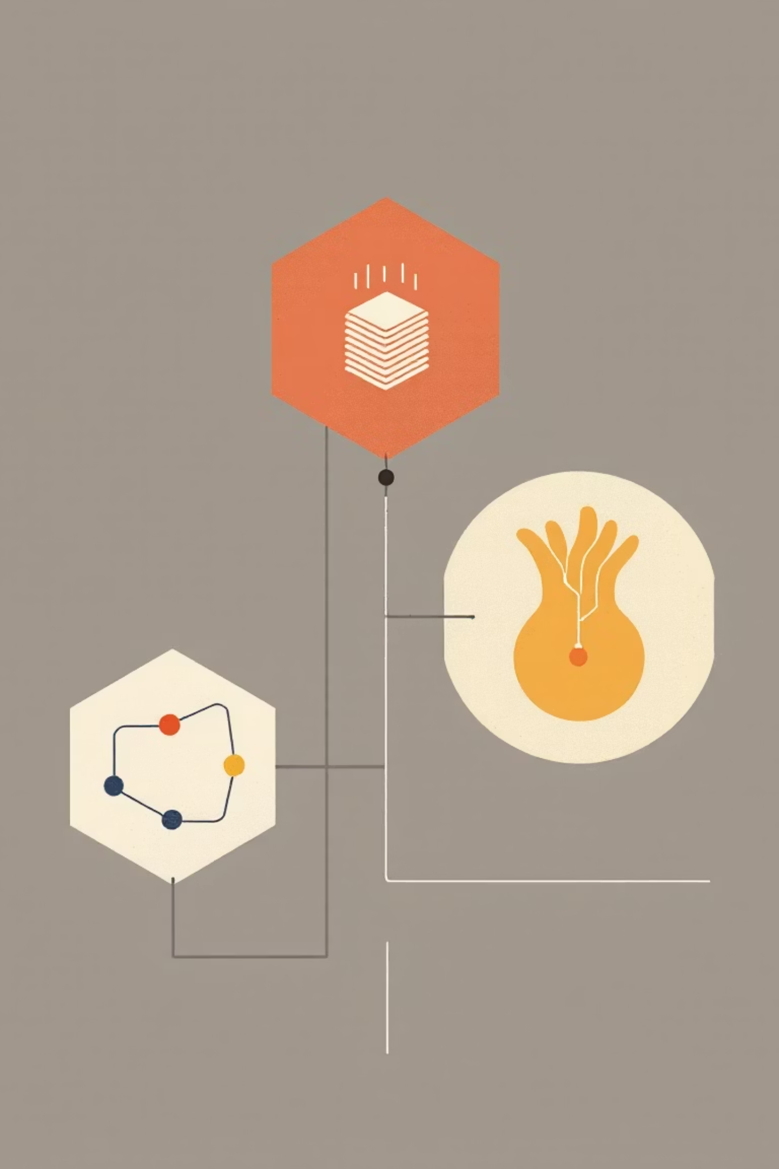
Comparative Summary: Model Strengths & Use Cases
AlexNet
ResNet101
A good baseline model, offering faster inference times. It is particularly suitable for deployment on systems with limited computational hardware resources.
Excels in achieving high accuracy for complex disease patterns. It is an ideal choice for intensive research applications and precision agriculture systems.
DenseNet201
Strikes an optimal balance between depth and efficiency. It is highly effective in feature-rich, multi-class classification tasks, offering robust performance.
All models significantly benefit from transfer learning and data augmentation techniques to overcome limitations posed by smaller or less diverse datasets, enhancing their generalisation capabilities.

Slide 18
Conclusion & Future Directions
1
2
3
Enhanced Accuracy
Cost-Effective Solutions
Technological Integration
Deep learning models like ResNet101 and DenseNet201 significantly improve citrus disease detection accuracy, enabling earlier and more effective intervention strategies.
Automated systems reduce reliance on expert manual diagnosis, leading to substantial savings in time and labour costs for farmers.
The integration of deep learning with mobile applications and drone technology has the potential to revolutionise orchard monitoring globally, including in India.
4
5
Ongoing Research
Sustainable Farming
Future efforts are focused on expanding datasets, improving model robustness, and developing lightweight models suitable for practical field deployment.
These advancements collectively promise healthier crops, higher yields, and more sustainable citrus farming practices for a secure agricultural future.

